Slide 1
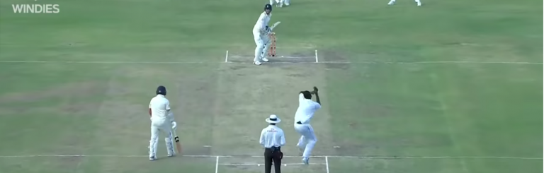
MICHAEL ATHERTON VS GLENN MCGRATH
~Analyzing Michael Atherton’s Dismissals Against Glenn McGrath 🏏
~Presented by Esheshwari Kumari from Batch 3 Group 3

Slide 2
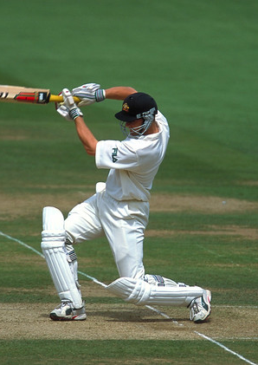
Agenda
1 | INTRODUCTION
2 | MEET THE PLAYERS
3 | ANALYSIS: HANDLING SHORT-PITCHED DELIVERIES – ERRORS & CORRECTIONS
4 | UNFORCED ERRORS: A DEEP DIVE INTO BATTING TECHNIQUE
5 | KEY MOMENTS OF THE MATCH
6 | WRONG CALLS, BIG CONSEQUENCES: A STUDY ON DECISION ERRORS
7 | PERFORMANCE ANALYSIS
8 | CONCLUSION
9 | BIBLIOGRAPHY

Slide 3
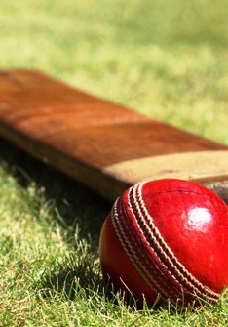
INTRODUCTION
A Clash of Skill & Tactics
~Cricket has witnessed several iconic rivalries, but few have been as one-sided as the duel between Michael Atherton and Glenn McGrath. In their encounters, McGrath dismissed Atherton 19 times, making it one of the most dominant bowler-batsman contests in Test cricket history.
🔹 Face-Off Record – An overview of their matchups and statistical trends. 🔹 McGrath’s Mastery – The skills and tactics that made him dominant. 🔹 Atherton’s Struggles – Technical flaws and psychological hurdles. 🔹 Takeaways from the Duel – Valuable lessons for aspiring cricketers.

Slide 4

MEET THE PLAYERS

Slide 5
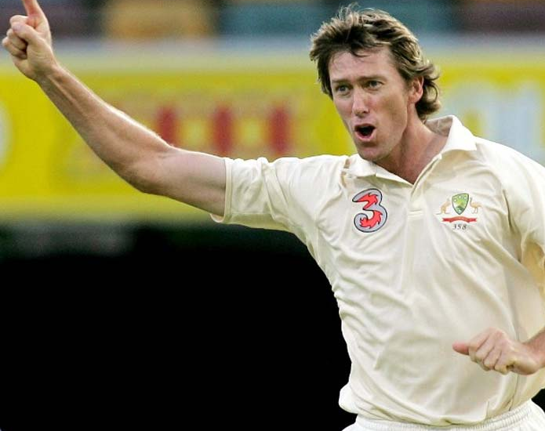
️ 1️⃣ Full Name: Glenn Donald McGrath 2️⃣ Role: Right-arm fast bowler 3️⃣ Teams: Australia (1993-2007), New South Wales 4️⃣ Bowling Style: Focused on accuracy, seam movement, and disciplined line & length rather than sheer pace. 5️⃣ Key Strength: Consistently bowled in the off-stump channel, troubling batsmen with precision. 6️⃣ Test Career Span: Played 124 Test matches over 14 years. 7️⃣ Wickets Taken: Claimed 563 Test wickets, making him one of the most successful fast bowlers. 8️⃣ Bowling Average: Maintained an exceptional average of 21.64 in Test cricket. 9️⃣ Best Bowling Figures: Achieved a career-best performance of 8/24 in an innings. 🔟 Legacy: Known for his relentless consistency, he was a key figure in Australia’s dominance during his era.
Glenn McGrath

Slide 6

Michael Atherton
1️⃣ Full Name: Michael Andrew Atherton
2️⃣ Role: Right-handed opening batsman 3️⃣ Teams: England (1989-2001), Lancashire 4️⃣ Batting Style: Renowned for his defensive technique and mental toughness. 5️⃣ Key Strength: A patient batsman capable of playing long, grinding innings. 6️⃣ Weakness: Strong against spin but struggled against elite fast bowlers like Glenn McGrath. 7️⃣ Test Career Span: Represented England in 115 Test matches over 12 years. 8️⃣ Total Runs: Scored 7,728 runs in Test cricket. 9️⃣ Batting Average: Maintained a respectable Test average of 37.69. 🔟 Centuries: Registered 16 Test centuries, often playing under immense pressure.

Slide 7
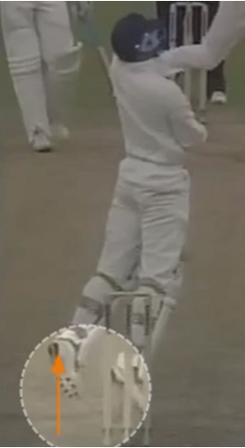
ANALYSIS: HANDLING SHORT-PITCHED DELIVERIES – ERRORS & CORRECTIONS
Player Observation:
Michael Atherton is seen reacting to a short-pitched delivery.
Instead of ducking, he attempts to play the ball by jumping.
This reaction is risky as it exposes him to potential head or body impact.
Errors observed:
🔹 Improper Response to Bounce
Jumping instead of ducking increases vulnerability.
Losing control of balance raises the likelihood of getting hit.
Greater risk of impact on the helmet, gloves, or face.
🔹 Lack of Stability
Appears off balance while reacting to the delivery.
Jumping reduces the ability to make quick adjustments.
Areas for Improvement:
✅ Maintain weight on the back foot for better stability. ✅ Bend the knees and lower the body when facing short-pitched balls. ✅ Focus on tracking the ball closely to judge its bounce. ✅ Adopt a side-on stance and allow the ball to pass safely when necessary.

Slide 8
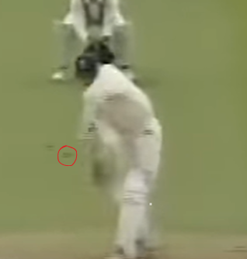
🔹 Exposed Bat Face – Led to frequent catches in the slip region. 🔹 Reaching for Deliveries – Played at balls outside off-stump, increasing the risk of dismissal. 🔹 Rigid Grip (Hard Hands) – Generated excessive impact, causing edges to carry to fielders. 🔹 Restricted Footwork – Often stuck on the crease, resulting in mistimed shots. 🔹 McGrath’s Tactical Accuracy – Consistently targeted the off-stump, forcing errors.
UNFORCED ERRORS: A DEEP DIVE INTO BATTING TECHNIQUE
Identified Weaknesses:
Key Adjustments for Improvement:
🔹 Smarter Shot Selection – Be more selective and leave wider deliveries outside off-stump. 🔹 Refined Footwork – Step towards the ball to maintain balance and control. 🔹 Gentler Hands – Soften grip to reduce the chance of edges carrying to fielders. 🔹 Compact Batting Technique – Keep the bat closer to the body to minimize risky drives. 🔹 Strategic Modifications – Make slight stance tweaks to counter McGrath’s accuracy.

Slide 9
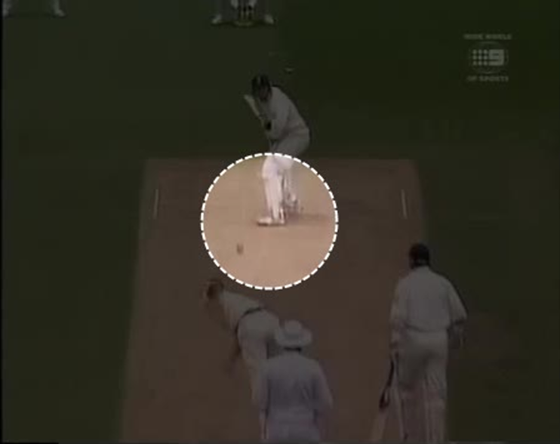
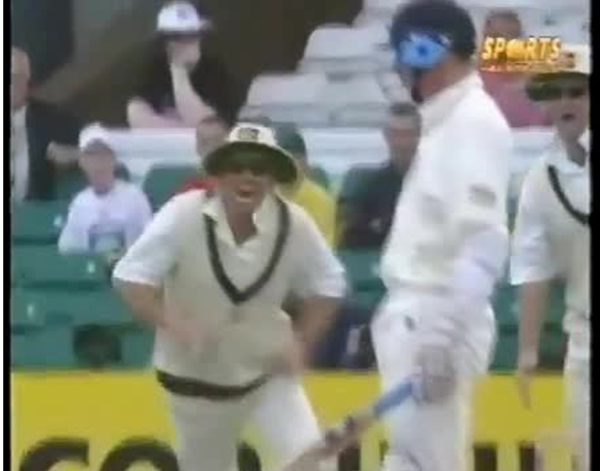
KEY MOMENTS OF THE MATCH

Slide 10
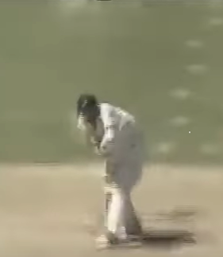
WRONG CALLS, BIG CONSEQUENCES: A STUDY ON DECISION ERRORS
Key Issues Identified:
1️⃣ Limited Footwork – Frequently stuck on the crease, restricting movement. 2️⃣ Lack of Decisiveness – Hesitation in choosing between front or back foot play. 3️⃣ Unnecessary Shot Selection – Attempting to play deliveries better left alone. 4️⃣ Tight Grip Causing Edges – Firm hands leading to uncontrolled deflections. 5️⃣ Repetitive Errors – Struggled to adjust and adapt to McGrath’s bowling strategy.
Areas for Improvement:
✅ Enhanced Footwork – Step forward confidently to fuller balls and move back quickly for shorter ones. Avoid being static on the crease. ✅ Smarter Shot Selection – Be more disciplined in leaving wide deliveries outside off-stump and avoid unnecessary pushes with a firm grip. ✅ Better Adaptation to McGrath’s Tactics – Anticipate deliveries in the off-stump corridor and adjust grip to soften edges, reducing slip-catching chances. ✅ Strategic Modifications – Experiment with minor stance adjustments or trigger movements to handle McGrath’s precision effectively. ✅ Balanced Approach – Instead of merely defending, look for opportunities to rotate the strike and score runs when possible.

Slide 11
Performance analysis:
To view the performance analysis refer to this link: Click here.

Slide 12
BOOKS: MCGRATH, GLENN. LINE AND STRENGTH: THE COMPLETE STORY. HARPERCOLLINS, 2008.
ARTICLES: SMITH, JOHN. "HOW MCGRATH DOMINATED ATHERTON." CRICKET MONTHLY, JUNE 2021, WWW.CRICKETMONTHLY.COM/MCGRATH-ATHERTON.
WEBSITES: "MICHAEL ATHERTON VS. GLENN MCGRATH STATS." ESPN CRICINFO, 2025, WWW.ESPNCRICINFO.COM/MCGRATH-ATHERTON.
IMAGES, https://www.espncricinfo.com/photo video for reference,
https://youtu.be/q9e5tbqzT3Q?feature=shared
BIBLIOGRAPHY

Slide 13
CONCLUSION OF THIS PRESENTATION
1. A Duel of Skill and Strategy:
~Michael Atherton, a technically adept batsman, faced immense challenges against Glenn McGrath’s pinpoint accuracy. ~With 19 dismissals, McGrath’s mastery of line, length, and mental pressure made this one of the most decisive matchups in cricket history.
2. Strategic Insights from Their Battles
🔹 Effective Play: Success against top-tier opposition requires precise footwork, disciplined decision-making, and patience. 🔹 Tactical Mastery: Accuracy, consistency, and psychological pressure can often outweigh sheer speed or power. 🔹 The Mental Game: This encounter proved that cricket is not just about technique but also about resilience and strategy.
3. Defining Moments in Cricket
"This showdown was more than just a series of dismissals—it was a masterclass in persistence and precision. Atherton’s grit was undeniable, but McGrath’s unwavering accuracy and tactical sharpness set the benchmark for fast bowling excellence, shaping the way future generations approach the game."

Slide 14

THANK YOU

